Slide 1
TURF FOOTBALL BOOKING WEBSITE
Syed Moinuddin S. - RA1631005010057
Madesh B. - RA1631005010073
Praveen Kumar D.C. - RA1631005010054
Guide, Mr. M. R. Vinoth Assistant Professor,
Department of Computer Science

Slide 2
INTRODUCTION
Football is always a family of team sports that involve, to varying degrees, kicking a ball to score a goal.
Artificial turf are surface made of synthetic fibers which look like natural grass. It is mostly used for sports that are normally played on grass.
The main objective of this website is to make football enthusiast feel comfortable Booking their ground for their available time and enjoy playing football in a world class ground.

Slide 3
EXISTING SYSTEM
The existing system for booking of a turf football ground is more of manual work and involves physical money. Due to this the existing system lacks popularity and has no proper response. And more over the customers are not aware with up to date information happening in the association. The is no method to send feedback to the management and to express their views.
And some of its major disadvantages are,
Lack of security of data
The existing system does not have proper security as the system the management of data are done on papers and the fact that manual work are not often accurate and slow.

Slide 4
EXISTING SYSTEM
No proper response
Lack of proper response as all process are handled by human and it is hard for human to respond to all requests.
Lack of popularity
The existing system using only physical banners and spread by mouth method it is slow and does not reach lots of people. Digital methods are always a way more reachable to people fast.
Lots of human work
The existing method uses lots of human resources this reduces human efforts.

Slide 5
EXISTING SYSTEM
Time consuming.
Manual work consumes lot of time as humans are not as fast as machines are. So, this also has an advantage of saving a lot of time.
Consumes large volume of paper work.
This manual and man-made work consumes lot of papers and paper work and it is a tedious process.
Needs manual calculations.
Man may make mistake but machines will not sot all calculations and transactions are made digital which makes it safer and accurate without any calculation’s mistakes.

Slide 6
PROPOSED SYSTEM
Proposed system is a website for football freaks and fans booking football ground at any time of their need. The proposed system is fast and more efficient, the system can reach out to lot of people easily further the users can send feedback to the admin and suggestions using the feedback form. With this admin can add all those new information and pricing and other activities happening in academy and keeps the customer updated.

Slide 7
PROPOSED SYSTEM
The manual way of reaching out for the customers and managing their user data and keep them updated is rectified by implementing computerization.
Booking slots becomes extremely easy as websites can be accessed from anywhere and any device. Users get a clear view of booked slots and can book according to the available slots and more over this does not include physical money as user can pay using digital methods like debit, credit cards, Paytm or any other digital wallet. Customers can be up to date with the subscription to the newsletter through the website and can also send feedbacks and review of their thoughts to the admin.

Slide 8
PROPOSED SYSTEM
The advantages are,
Fast access of database
Reaching a wide range of people
Secured user database without paper works
Highly efficient than standard way of communicating with users

Slide 9
SYSTEM SPECIFICIFICATION
HARDWARE SPECIFICIFICATION
PROCESSOR : Intel dual core or above
PROCESSOR SPEED : 1.0 GHz or above
RAM : 1 GB RAM or above
HARD DISK : 20 GB hard disk or above
SOFTWARE SPECIFICATION
FRONT END : HTML, CSS, JavaScript
BACK END : MySQLi
SERVER-SIDE SCRIPTING : PHP

Slide 10
ARCHITECTURE DIAGRAM
Browser
HTML,
CSS,
Java script,
J query
INTERNET
USER
Access and store in DB
Php

Slide 11
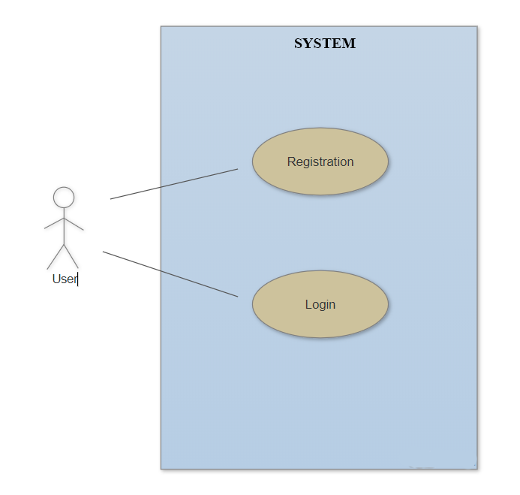
USECASE DIAGRAM

Slide 12
MODULE DESCRIPTION
A module is a collection of source files and coding that allow us to divide our project into discrete units of functionality. Our project can have one or many modules and one module may use another module as a dependency. Each module can be independently coded, and tested. Additional modules are often useful when creating code libraries within our own project or when we want to create different sets of code and resources for different device types keep all the files scoped within the same project and share some code. Modules utilized in this are
REGISTRATION MODULE
LOGIN MODULE
BOOKING MODULE
PAYMENT MODULE
SUCCESS MODULE
FEEDBACK MODULE

Slide 13
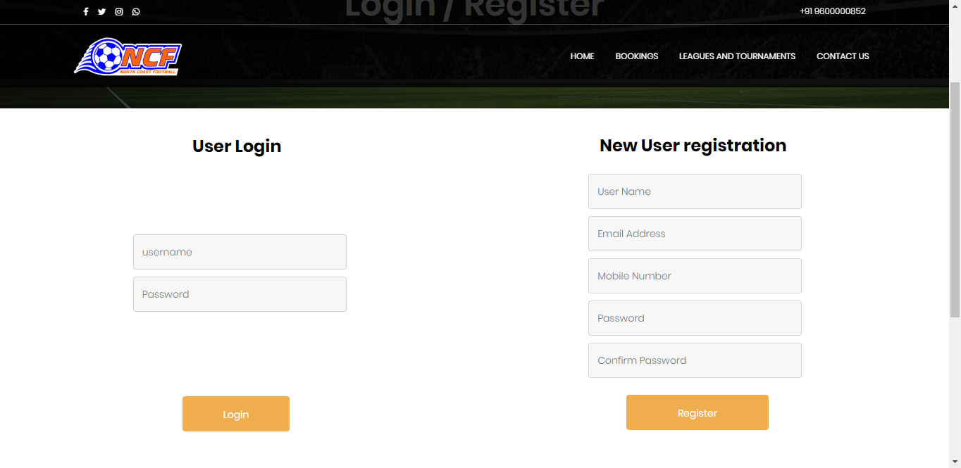
REGISTRATION & LOGIN MODULE
The registration module has five textboxes where new users will register themselves by providing the required details and password. They get a popup saying registered on successful registration and error on conditions like using user name which already exist and typing password and confirm password wrong.
The login module has two text box which are username and password once successful registration the users need to login to access the website.

Slide 14
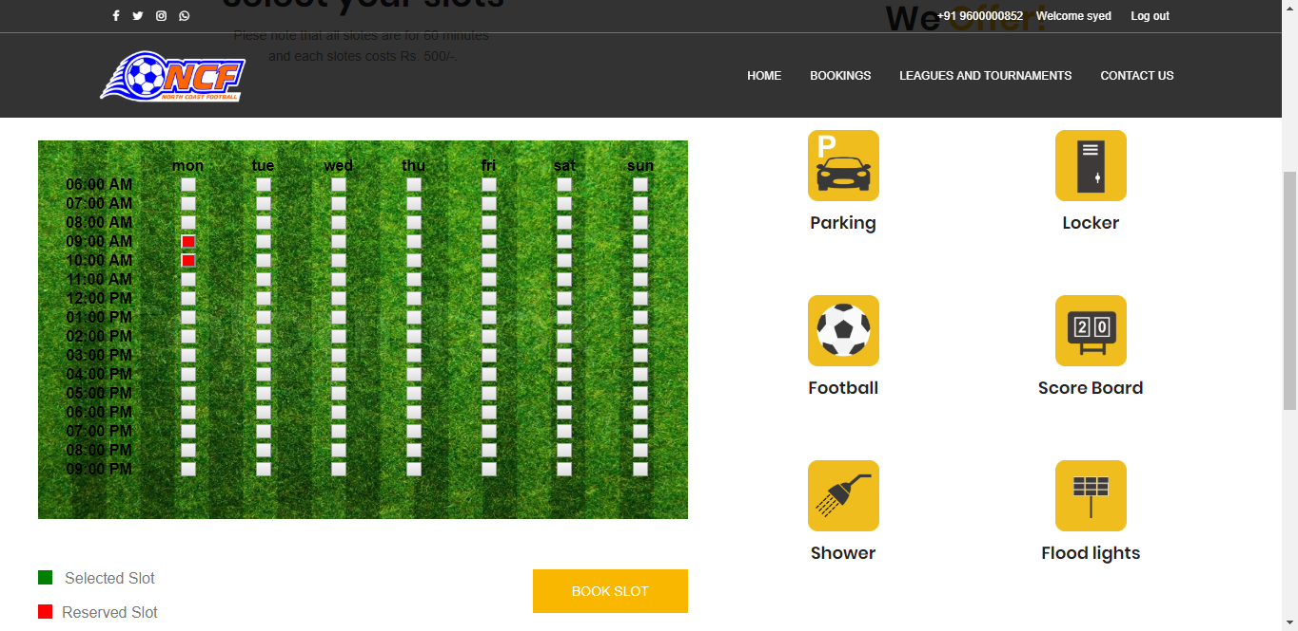
BOOKING MODULE
The booking module has slots which can be selected by clicking on it the user needs to select the required slots and proceed with the booking.

Slide 15
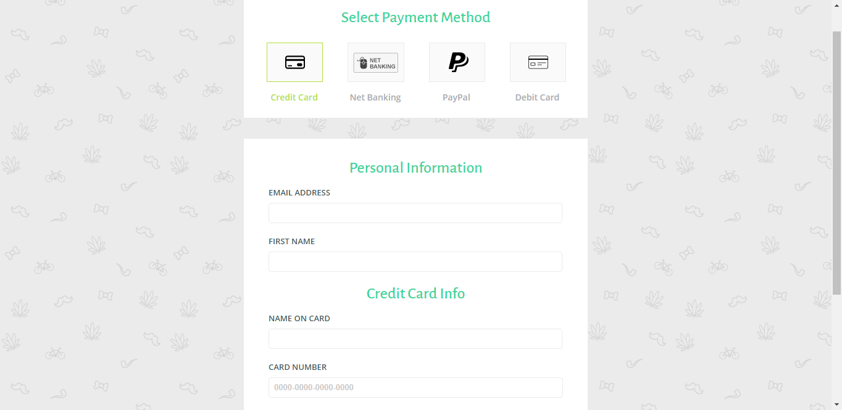
PAYMENT MODULE
This module is a dummy module which looks like a original payment module which ahs several payment methods.

Slide 16
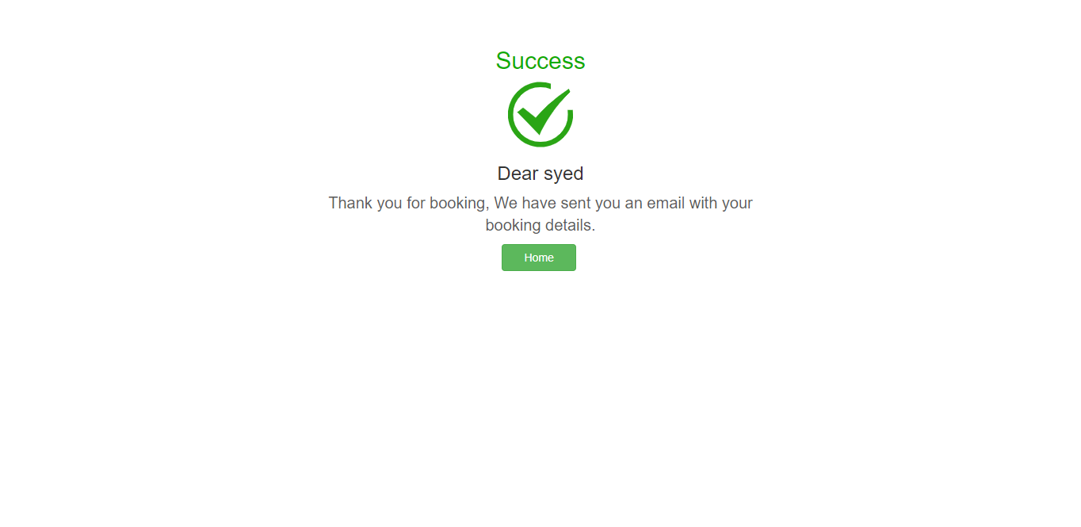
SUCCESS MODULE
Success module is nothing but a success page on successful payment which displays the user name followed by a success message.

Slide 17
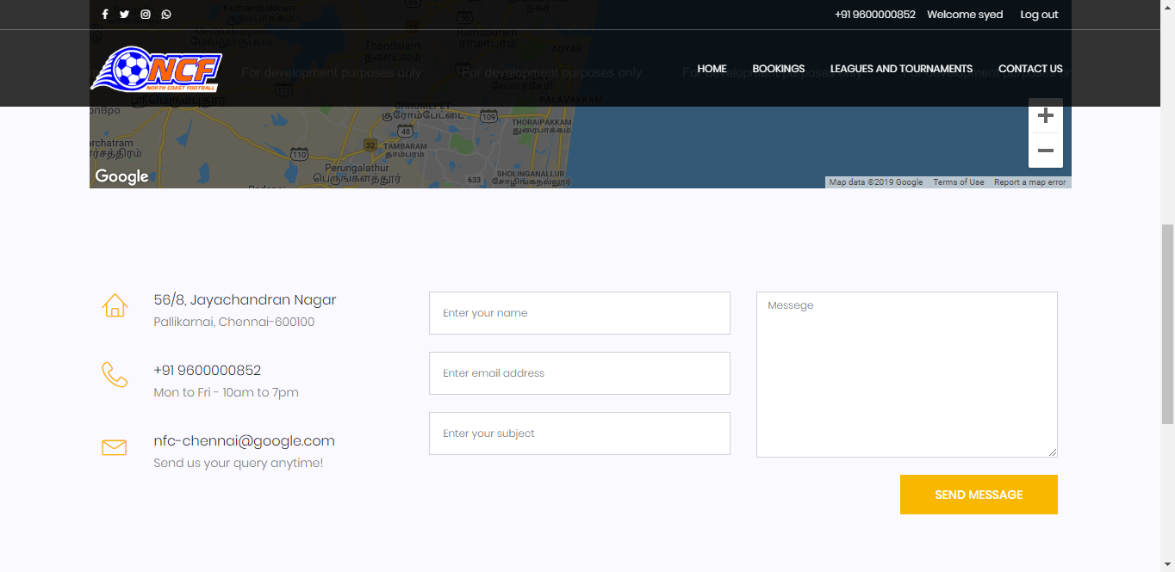
FEEDBACK MODULE
This is a form with three textbox and a text area through which users can submit their feedback.

Slide 18
CONCLUSION
The website allows the users to find all the needed information without any issues and also with updated details. This website makes it easy to book ground based on slots available making it easier for users to book and pay through digital methods and they can subscribe to the newsletter to keep them up to date with events happening in association and about offers.
The website acts as a great place for football enthusiast for all their football needs. Also, this website can be made more secure with the advancement in technologies and that auto response system can also added in this system for customer feedback using AI.
Technologies are growing day by day and that this website can be developed more and more with the advancement and this website acts as a great platform to football fans.

Slide 19
QUESTIONS

